Slide 1

Information Technology Project Management
Surendra K.C.

Slide 2
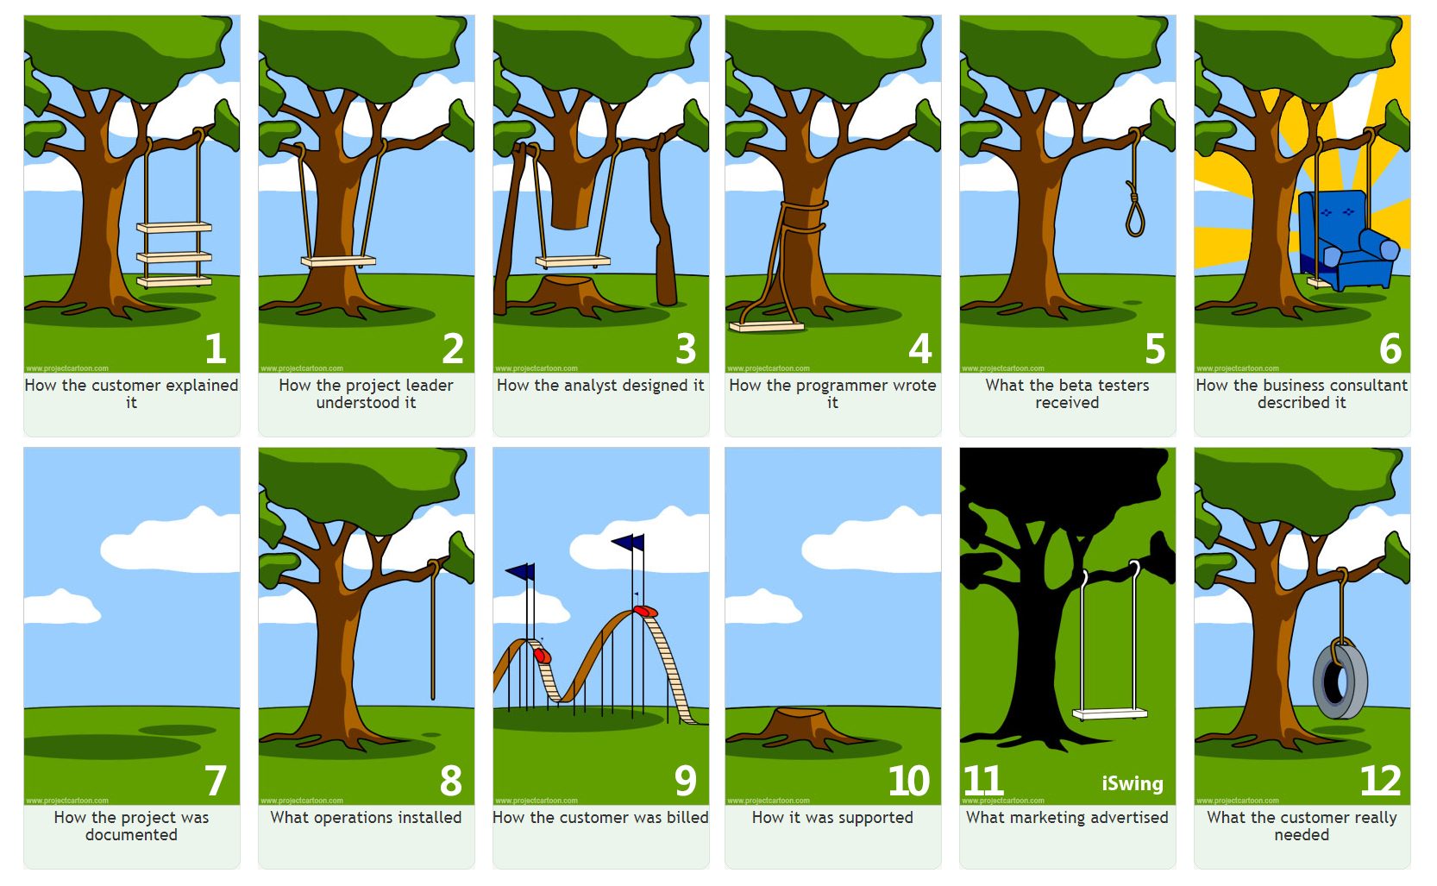

Slide 3
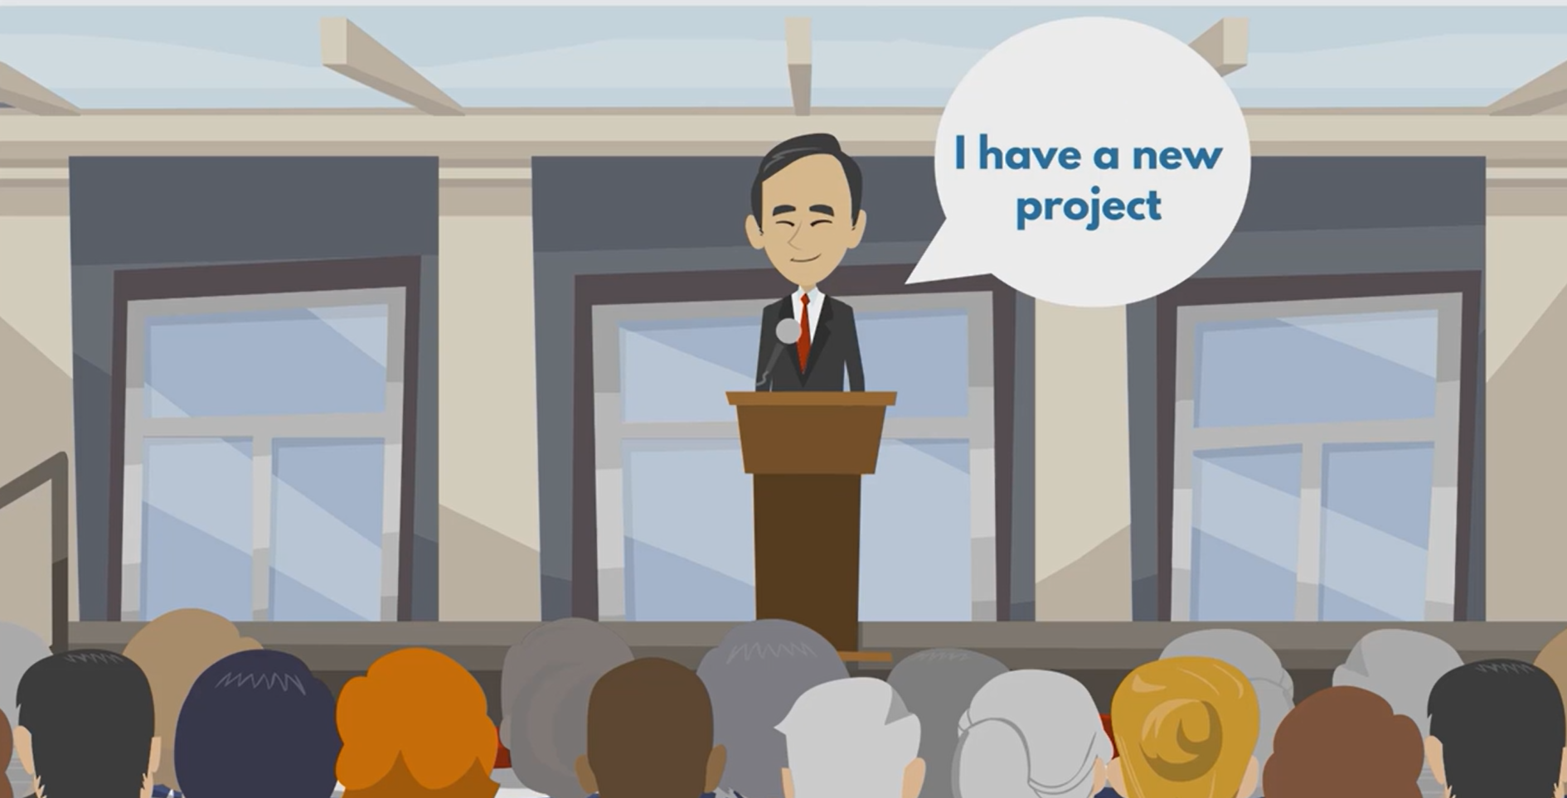

Slide 4
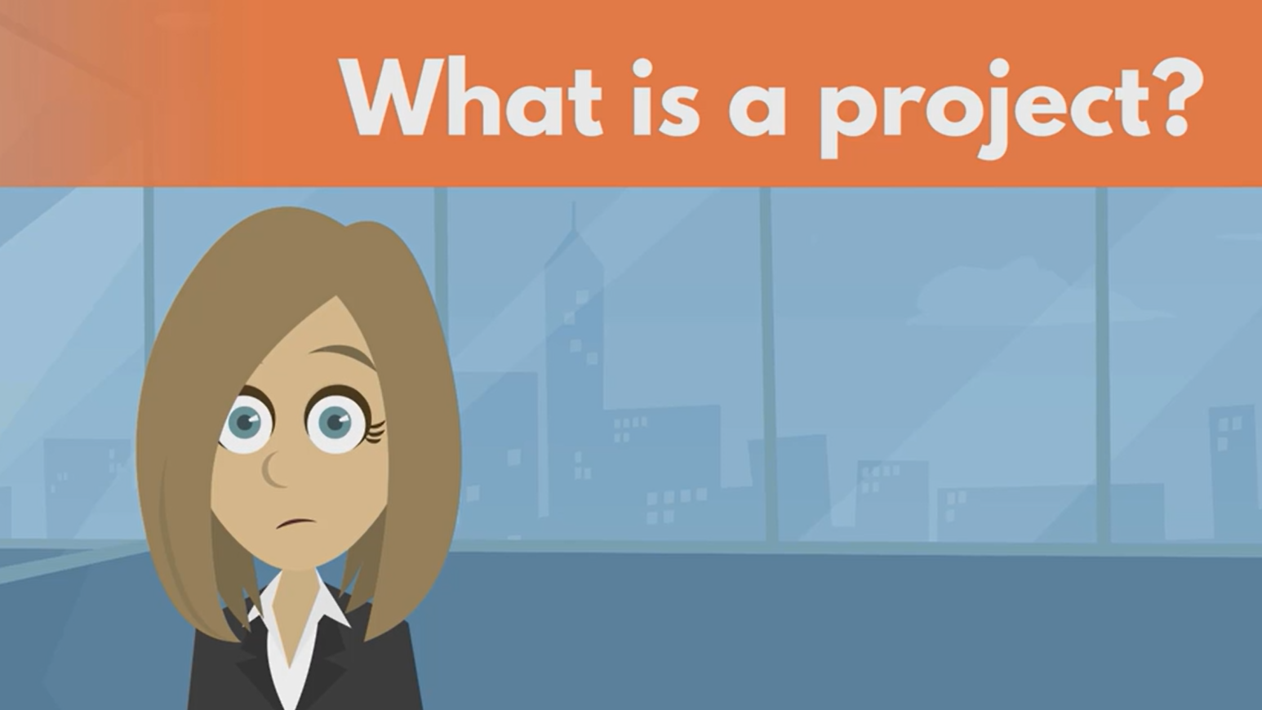

Slide 5
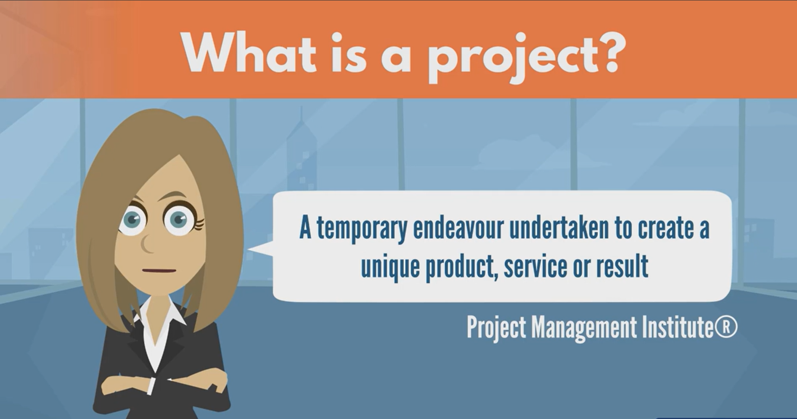

Slide 6
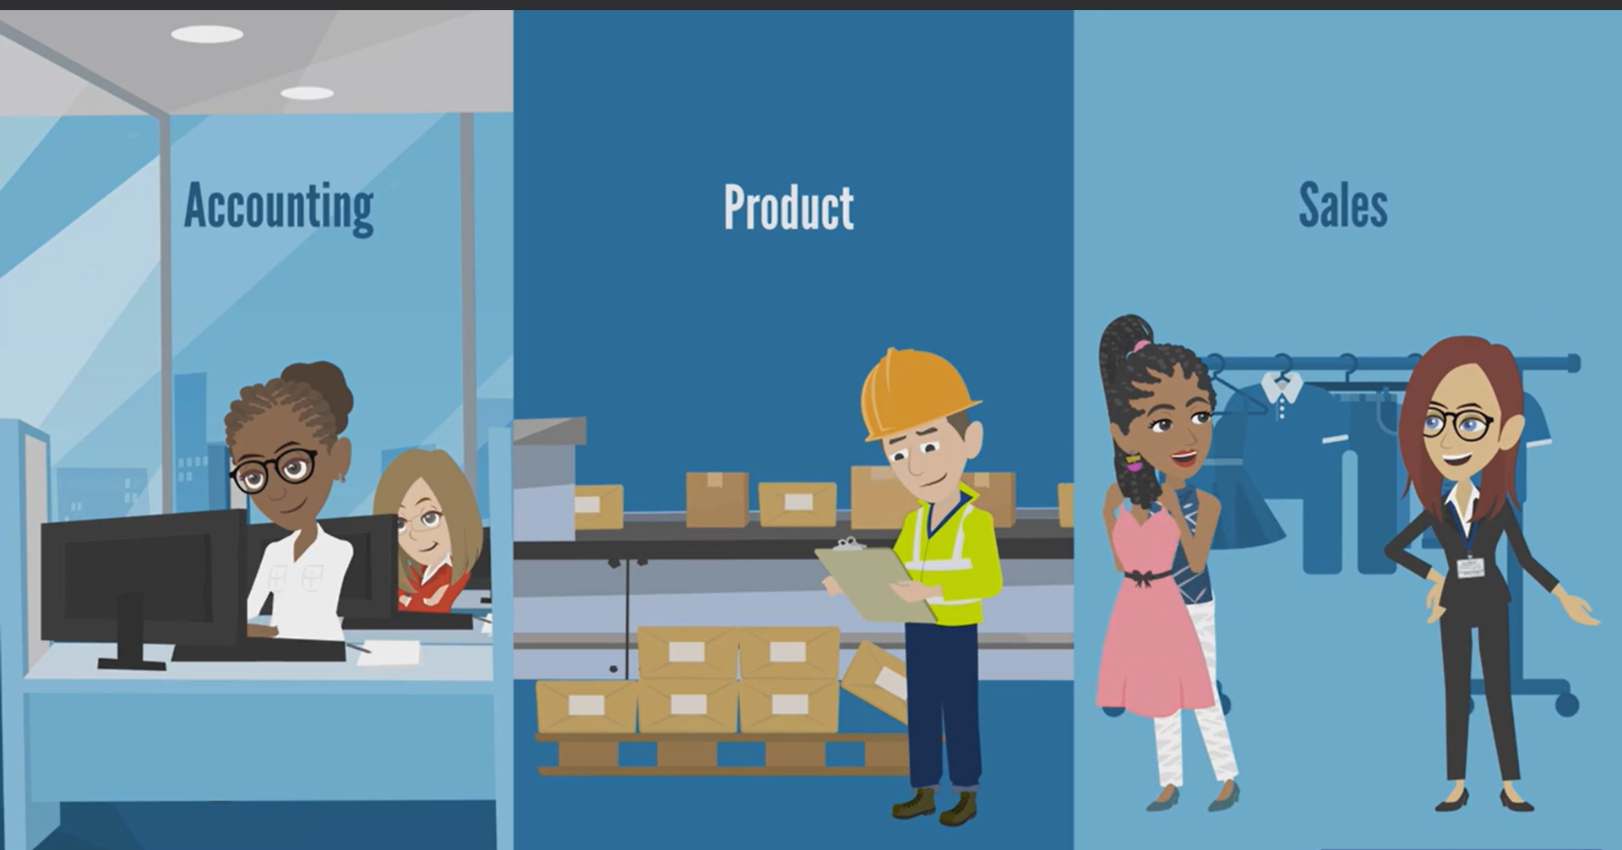

Slide 7
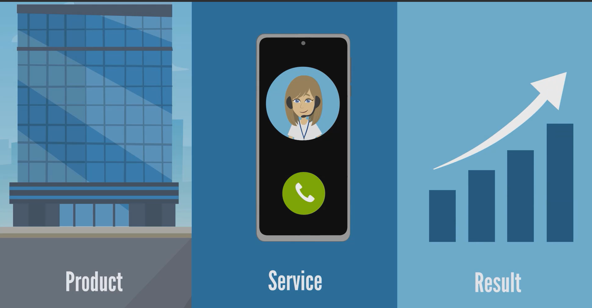

Slide 8
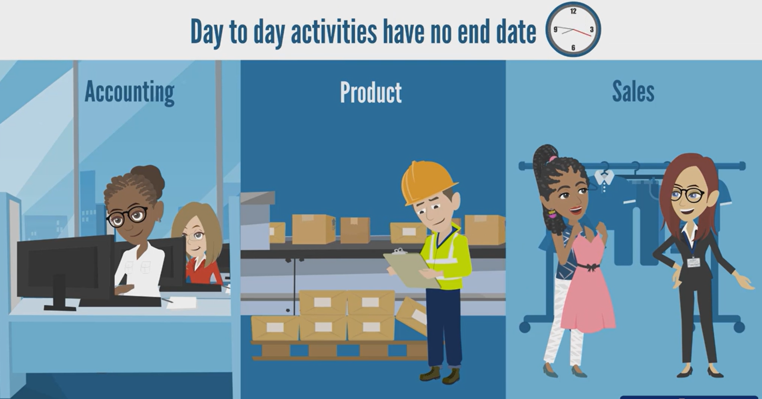

Slide 9
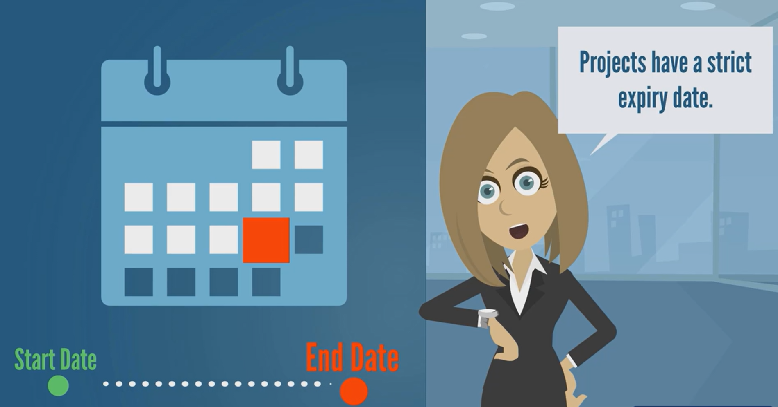

Slide 10
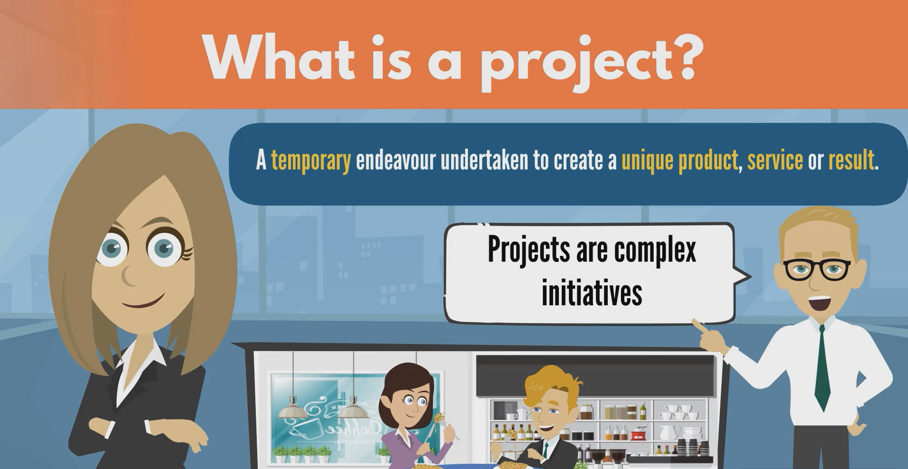

Slide 11
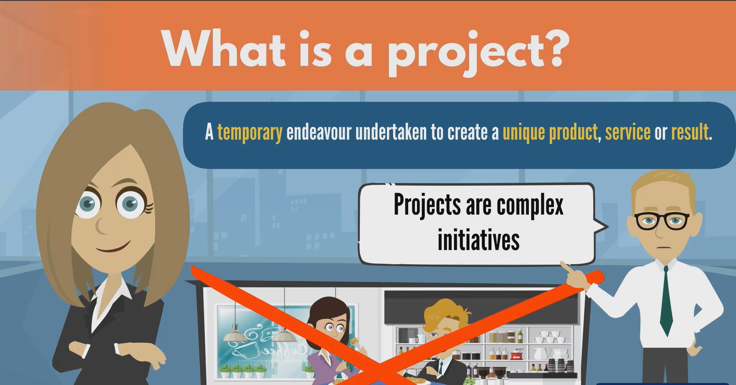

Slide 12
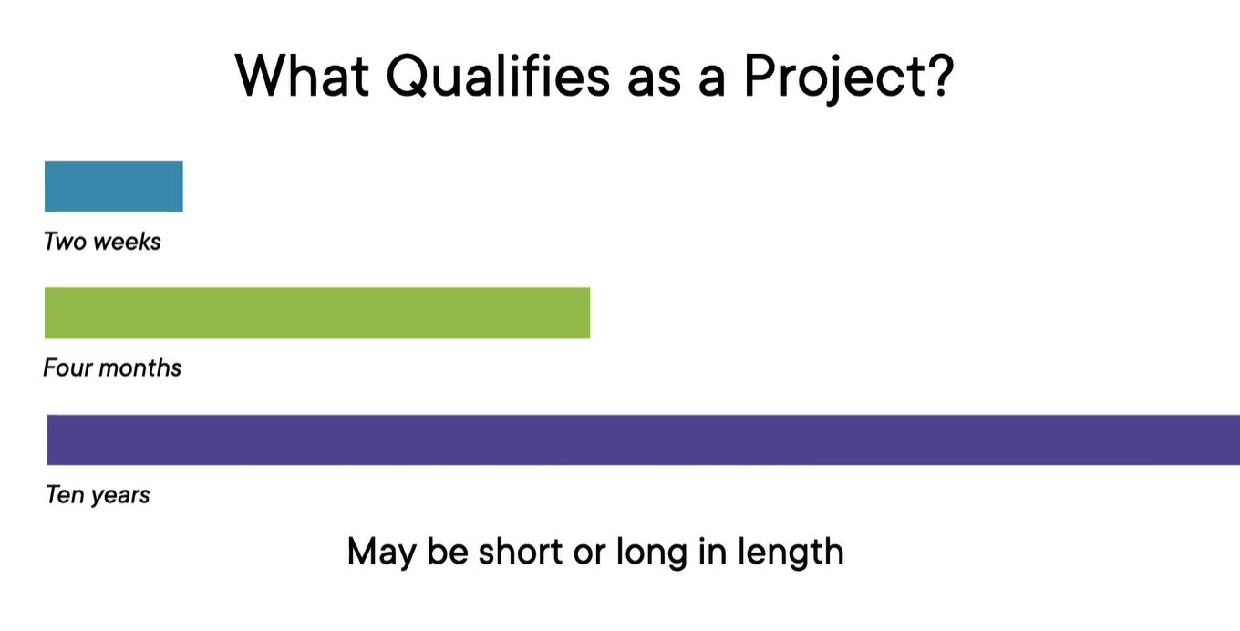

Slide 13
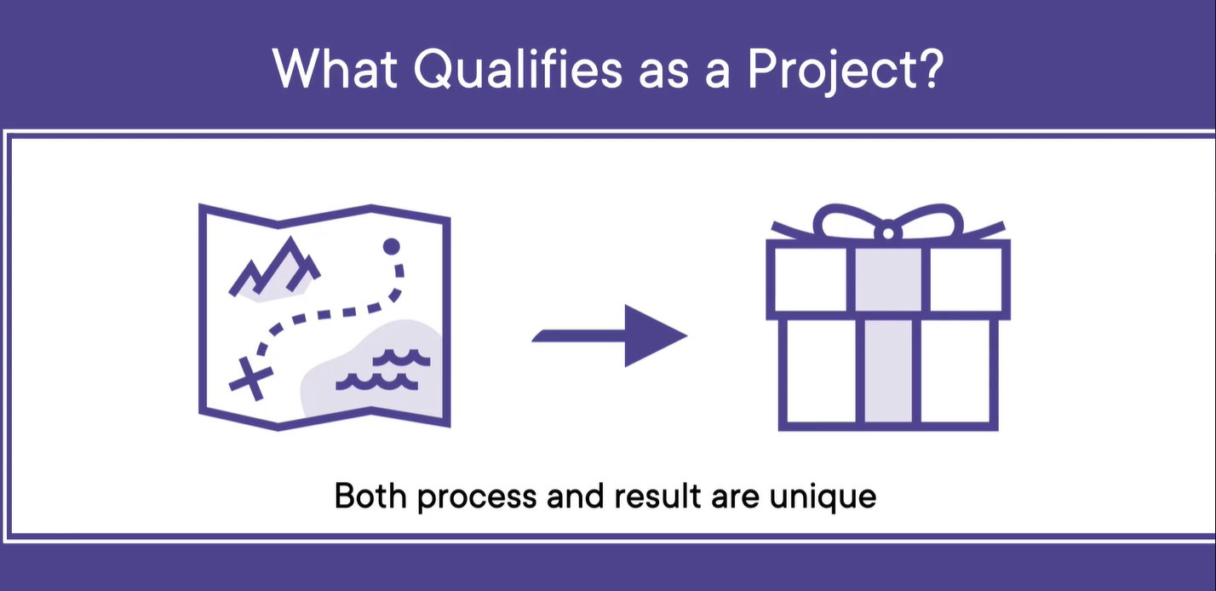

Slide 14
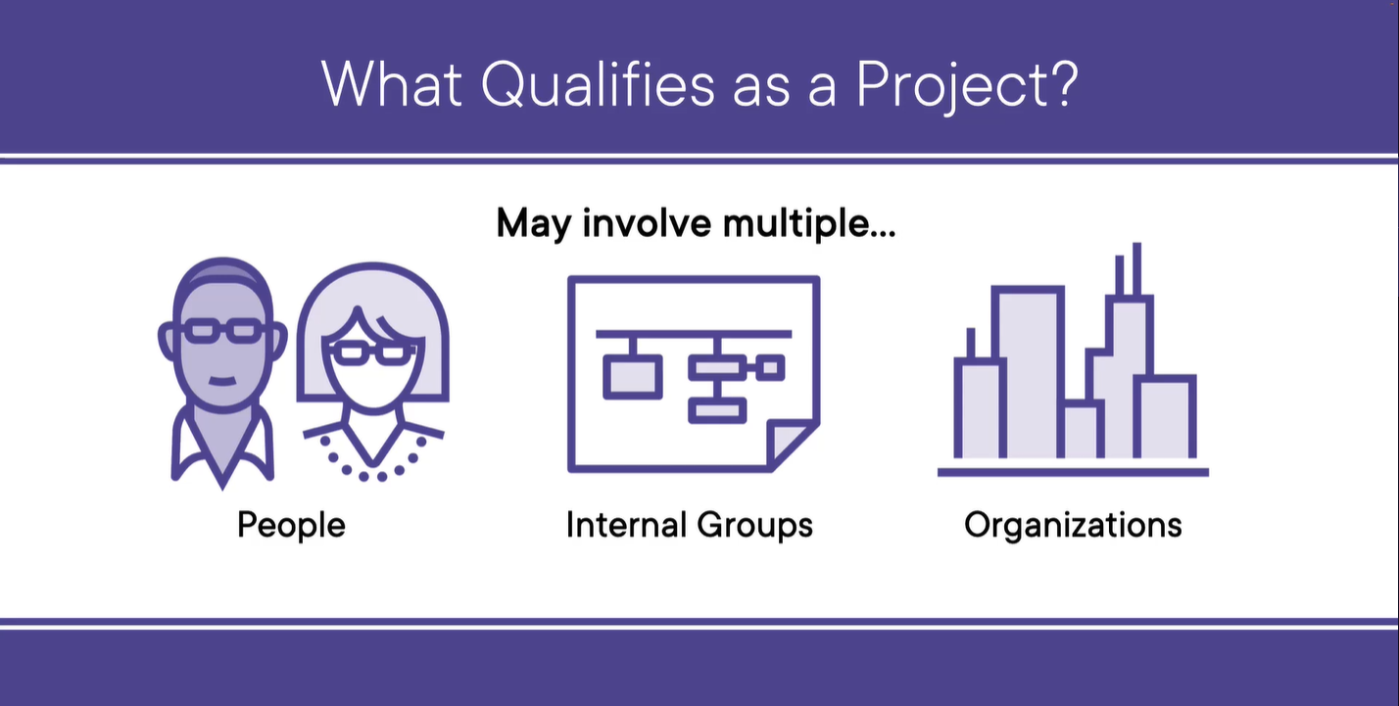

Slide 15
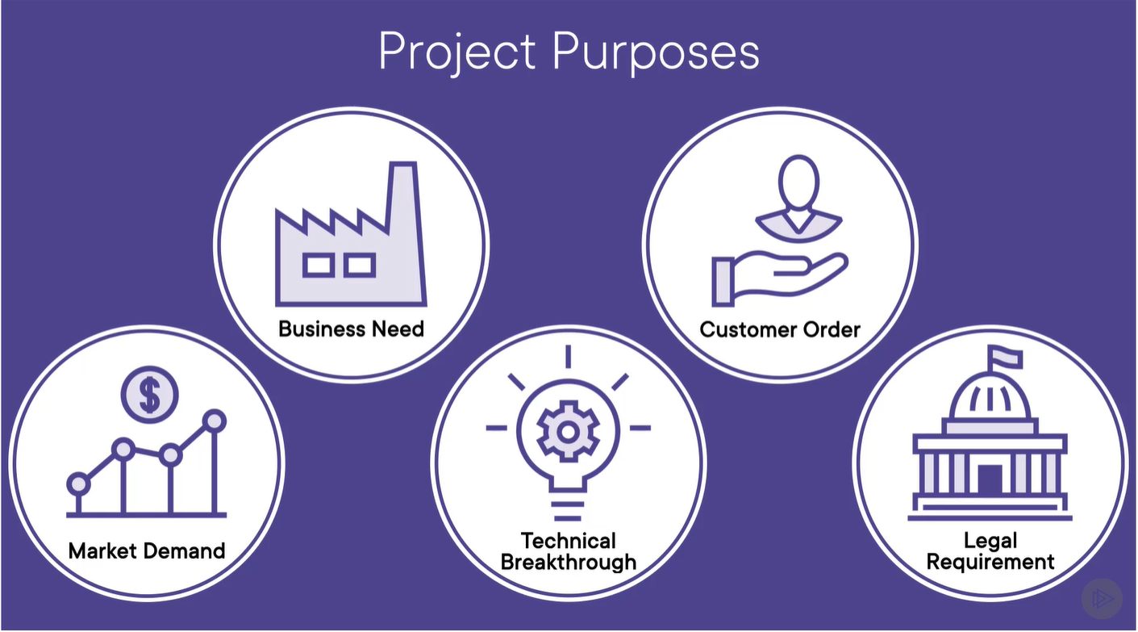

Slide 16
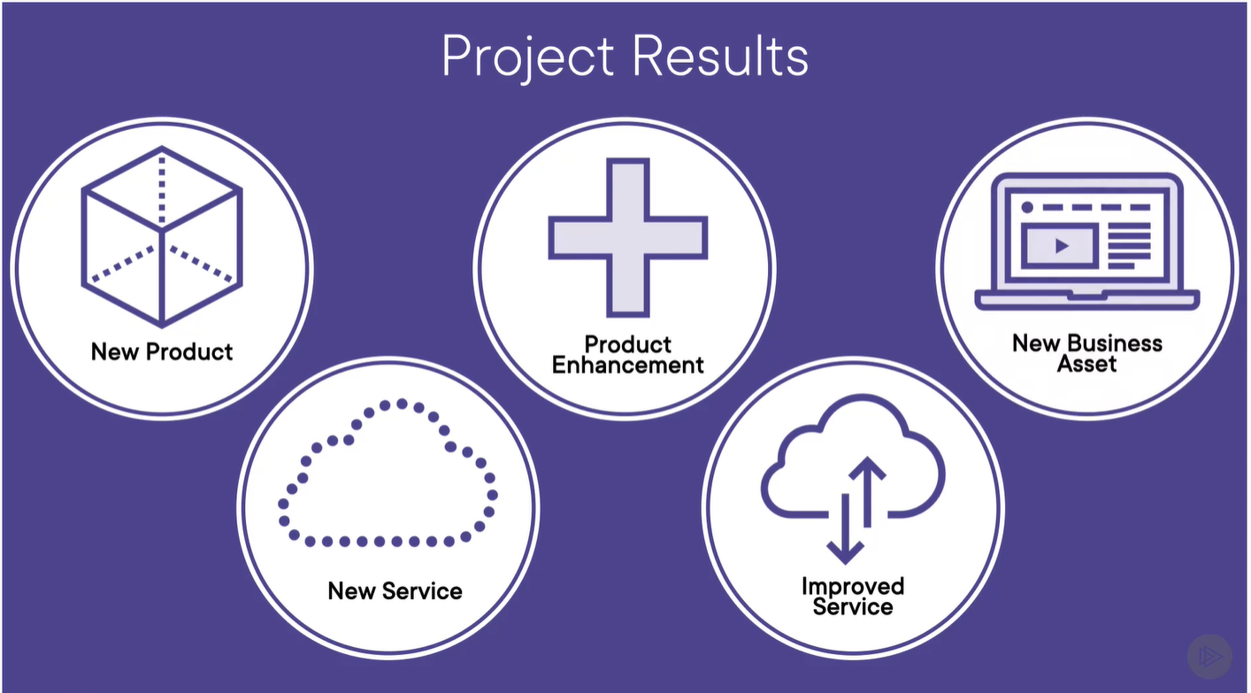

Slide 17
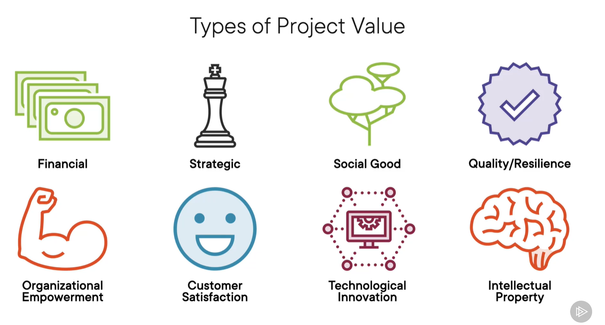

Slide 18
MCQ
1. What is the primary characteristic of a project?
A. It is ongoing and repetitive B. It produces a unique product, service, or result C. It has no specific goal D. It is permanent in nature
2. Which of the following best describes a project?
A. A routine task performed daily B. A temporary effort with a defined beginning and end C. A continuous process with no end D. A permanent organizational function
3.Which of the following is not a feature of a project?
A. Temporary nature B. Unique deliverables C. Repetitive operations D. Defined objectives

Slide 19
MCQ
4. What does the term "temporary" in project management imply?
A. The project will be repeated B. The project has a short duration C. The project has a defined start and end D. The project is not important
5. Which of the following is an example of a project?
A. Daily customer service operations B. Manufacturing the same product every day C. Developing a new mobile application D. Running a retail store

Slide 20
Project Management
Project management is the process of planning, organizing, and managing resources to achieve specific goals and complete a project successfully.
It involves applying knowledge, skills, tools, and techniques to meet the project requirements within defined constraints — typically scope, time, and cost.
Key Elements of Project Management
Initiation – Defining the project and getting approval.
Planning – Setting goals, timelines, budgets, and resources.
Execution – Carrying out the plan and managing teams.
Monitoring & Controlling – Tracking progress and making adjustments.
Closure – Completing the project and evaluating outcomes.

Slide 21
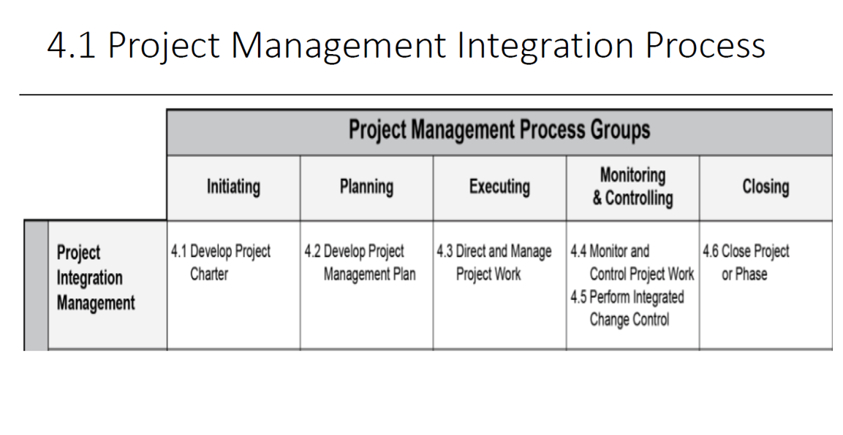

Slide 22
Project Management
Example in the IT Industry: Developing a School Management System
Initiation: A school wants a system to manage students, teachers, and attendance.
Planning: The IT team sets a 3-month timeline, defines features, and allocates a budget.
Execution: Developers write code, designers create interfaces, and testers check for bugs.
Monitoring: The project manager tracks progress using tools like Jira or Trello.
Closure: The system is delivered, feedback is collected, and documentation is completed.

Slide 23
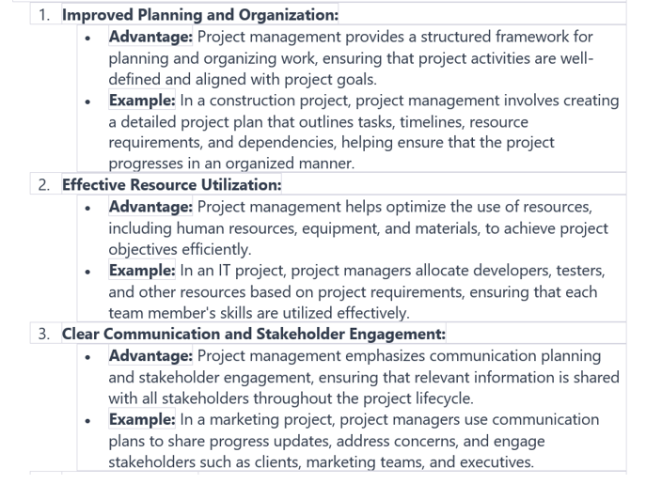
Project Management

Slide 24
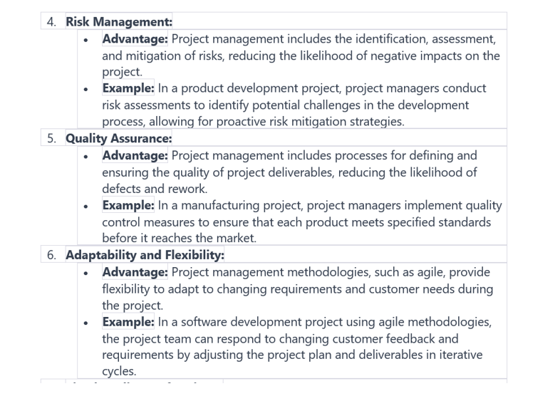
Project Management

Slide 25
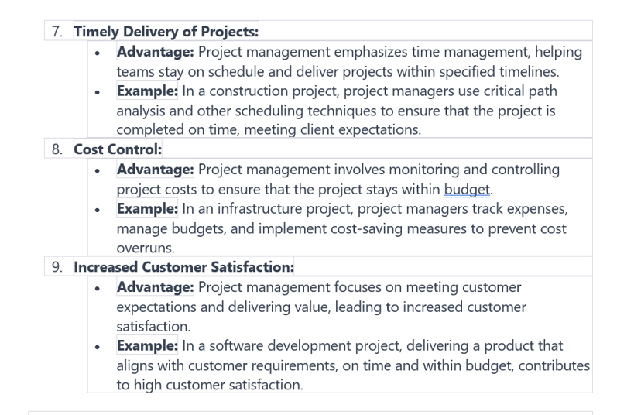
Project Management

Slide 26
MCQ
1. What is the main goal of project management?
A. To increase company profits B. To manage daily operations C. To achieve specific goals and complete a project successfully D. To hire new employees
2. Which of the following is not typically a constraint in project management?
A. Scope B. Time C. Cost D. Popularity
3. What does the initiation phase of project management involve?
A. Executing the project plan B. Defining the project and getting approval C. Monitoring progress D. Closing the project

Slide 27
MCQ
4. Which phase involves setting goals, timelines, budgets, and resources?
A. Execution B. Planning C. Closure D. Monitoring
5. What is the purpose of the execution phase?
A. To evaluate project outcomes B. To track progress C. To carry out the plan and manage teams D. To define project scope
6. What happens during the monitoring and controlling phase?
A. The project is closed B. Progress is tracked and adjustments are made C. Resources are allocated D. Teams are hired

Slide 28
MCQ
7. Which phase marks the formal end of a project?
A. Planning B. Execution C. Closure D. Initiation
8. What are the key elements of project management?
A. Budgeting, hiring, and firing B. Initiation, planning, execution, monitoring & controlling, closure C. Marketing, sales, and customer service D. Design, development, and testing
9. Which of the following best describes the planning phase?
A. Finalizing the project B. Defining the project scope and estimating resources C. Hiring team members D. Delivering the final product
10. Why is monitoring and controlling important in project management?
A. It helps reduce team size B. It ensures the project stays within scope, time, and cost C. It allows for skipping unnecessary steps D. It eliminates the need for planning

Slide 29
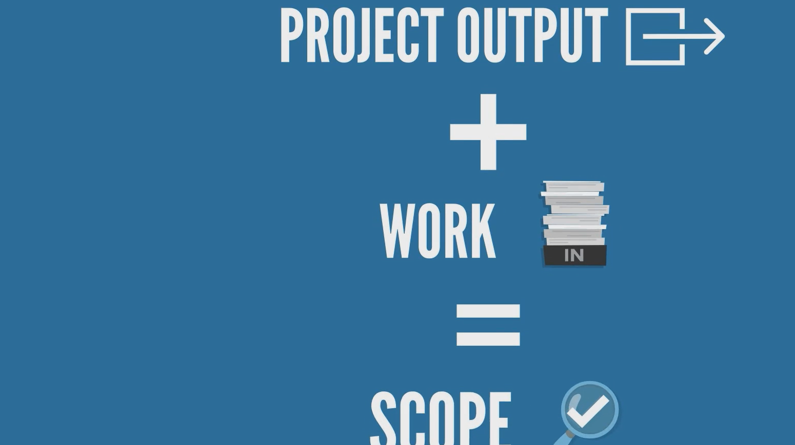

Slide 30


Slide 31
Temporary Endeavor - Uniqueness
This means that a project has a definite beginning and end. It doesn’t go on forever.
IT projects are not meant to run forever. They are planned with deadlines and milestones.
Developing a website for a local business. The project starts with planning, goes through design and development, and ends when the website is launched.
Uniqueness
A new software, application, or system.
A digital service that provides value to users.
A new insight, report, or analysis from data.

Slide 32
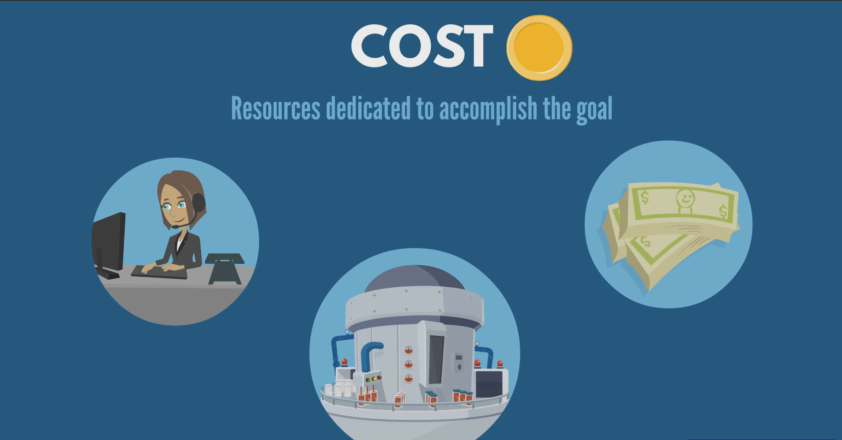

Slide 33
Project Cost
Cost refers to the total amount of resources (usually money) required to complete a project. It includes all expenses related to planning, executing, and closing the project.
Direct Costs
These are costs directly tied to the project work (Salaries of developers working in project, cost of purchasing h/w or s/w, travel expenses of project related meetins)
Indirect Costs
These are costs not directly linked to a specific task but necessary for the project (Office rent, utilities, administrative support)
Fixed Costs
Costs that remain constant regardless of project duration or scope (Software licenses, equipment rental fees)
Variable Costs
Costs that change depending on project activity or duration (Hourly wages, clous storage usages fees)

Slide 34
MCQ
1. What does "cost" in project management refer to?
A. Only the salaries of the project team B. The time taken to complete the project C. The total amount of resources required to complete a project D. The number of people involved in the project
2. Which of the following is an example of a direct cost?
A. Office electricity bill B. Administrative staff salary C. Developer’s salary working on the project D. Office rent
3. What is an example of an indirect cost in a project?
A. Travel expenses for a project meeting B. Cost of purchasing project-specific software C. Office rent and utilities D. Consultant fees for a specific task

Slide 35
MCQ
4. Which of the following is a fixed cost in project management?
A. Hourly wages of temporary staff B. Cloud storage usage fees C. Software license fees D. Travel expenses
5. What defines a variable cost in a project?
A. It stays the same regardless of project changes B. It is paid only at the end of the project C. It changes based on project activity or duration D. It is always included in the planning phase

Slide 36
Why Is Cost Important in Project Management?
Helps in budgeting and resource allocation
Ensures the project stays financially viable
Supports decision-making (e.g., choosing between vendors)
Affects project scope and timeline
Cost Type | Example
Direct Cost | Paying developers and designers
Indirect Cost | Internet bills and office space
Fixed Cost | Buying a design tool license
Variable Cost | Paying freelancers based on hours worked

Slide 37
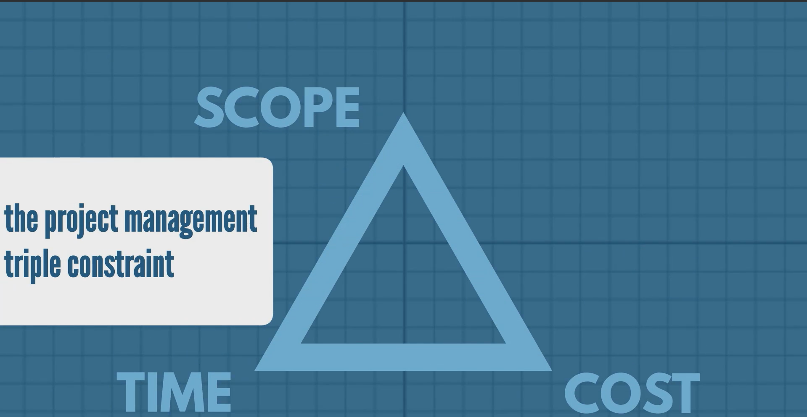

Slide 38
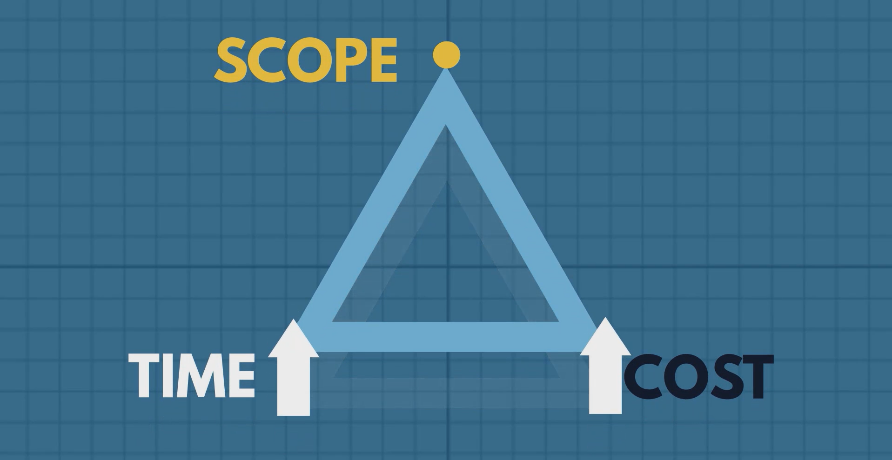

Slide 39
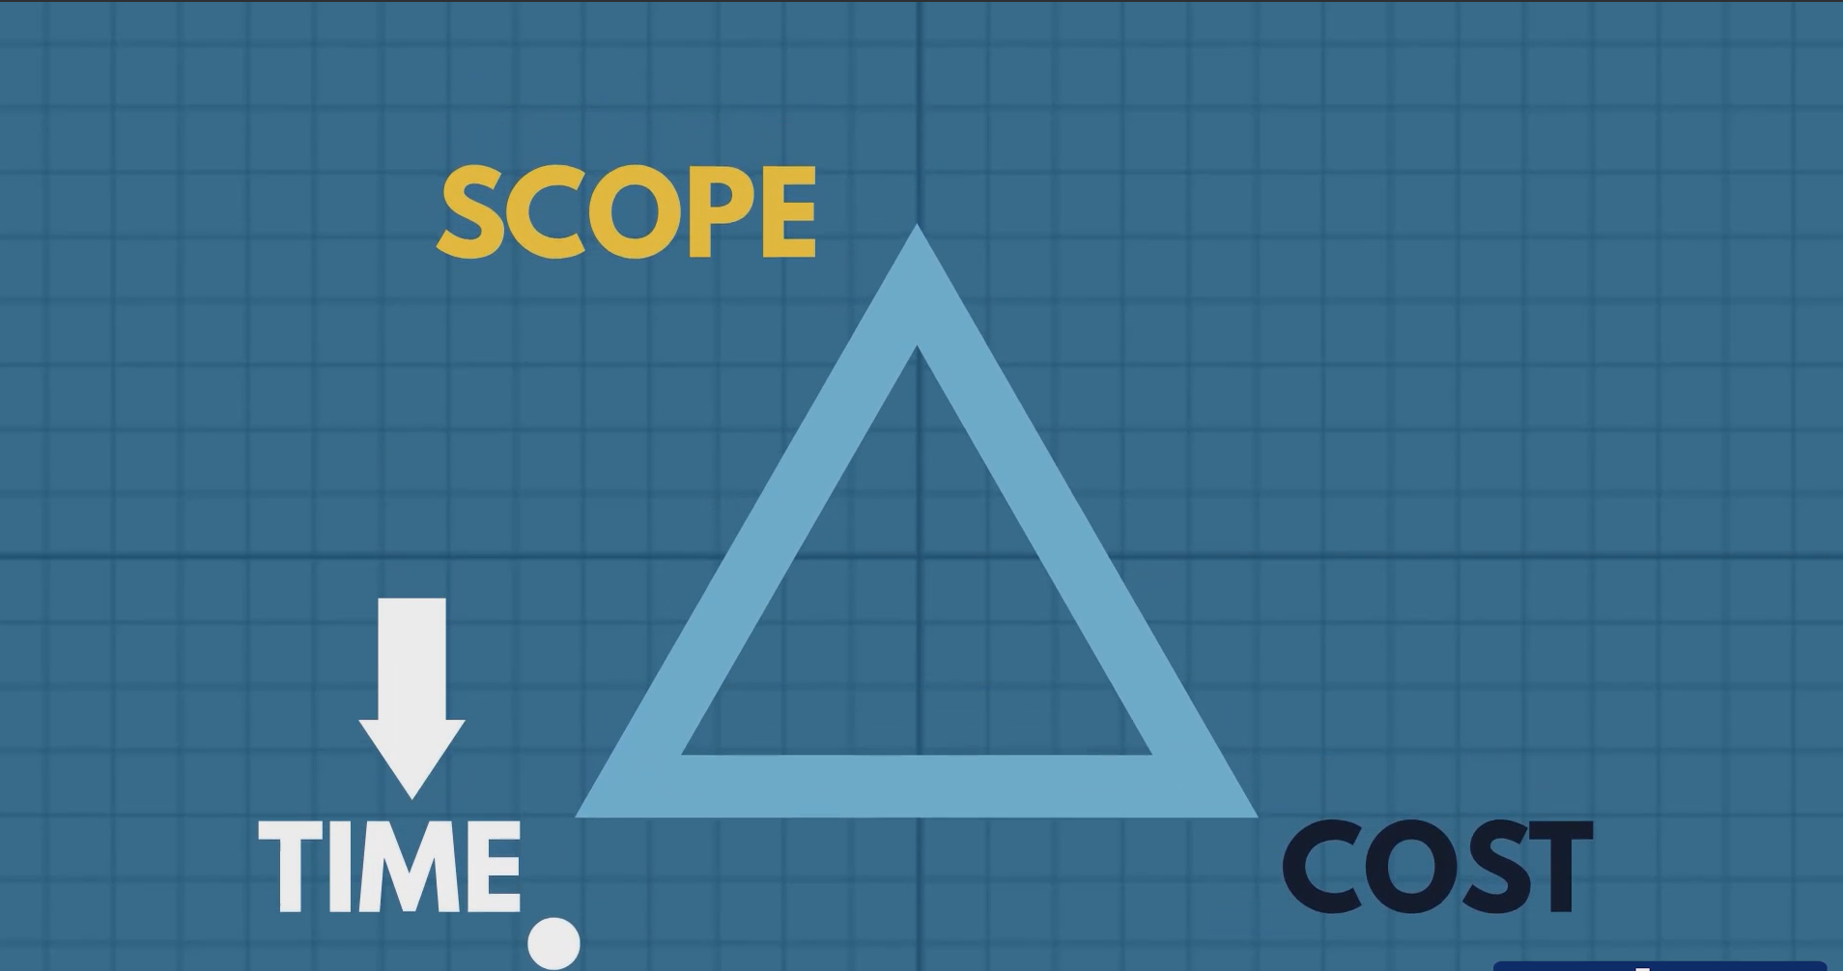

Slide 40
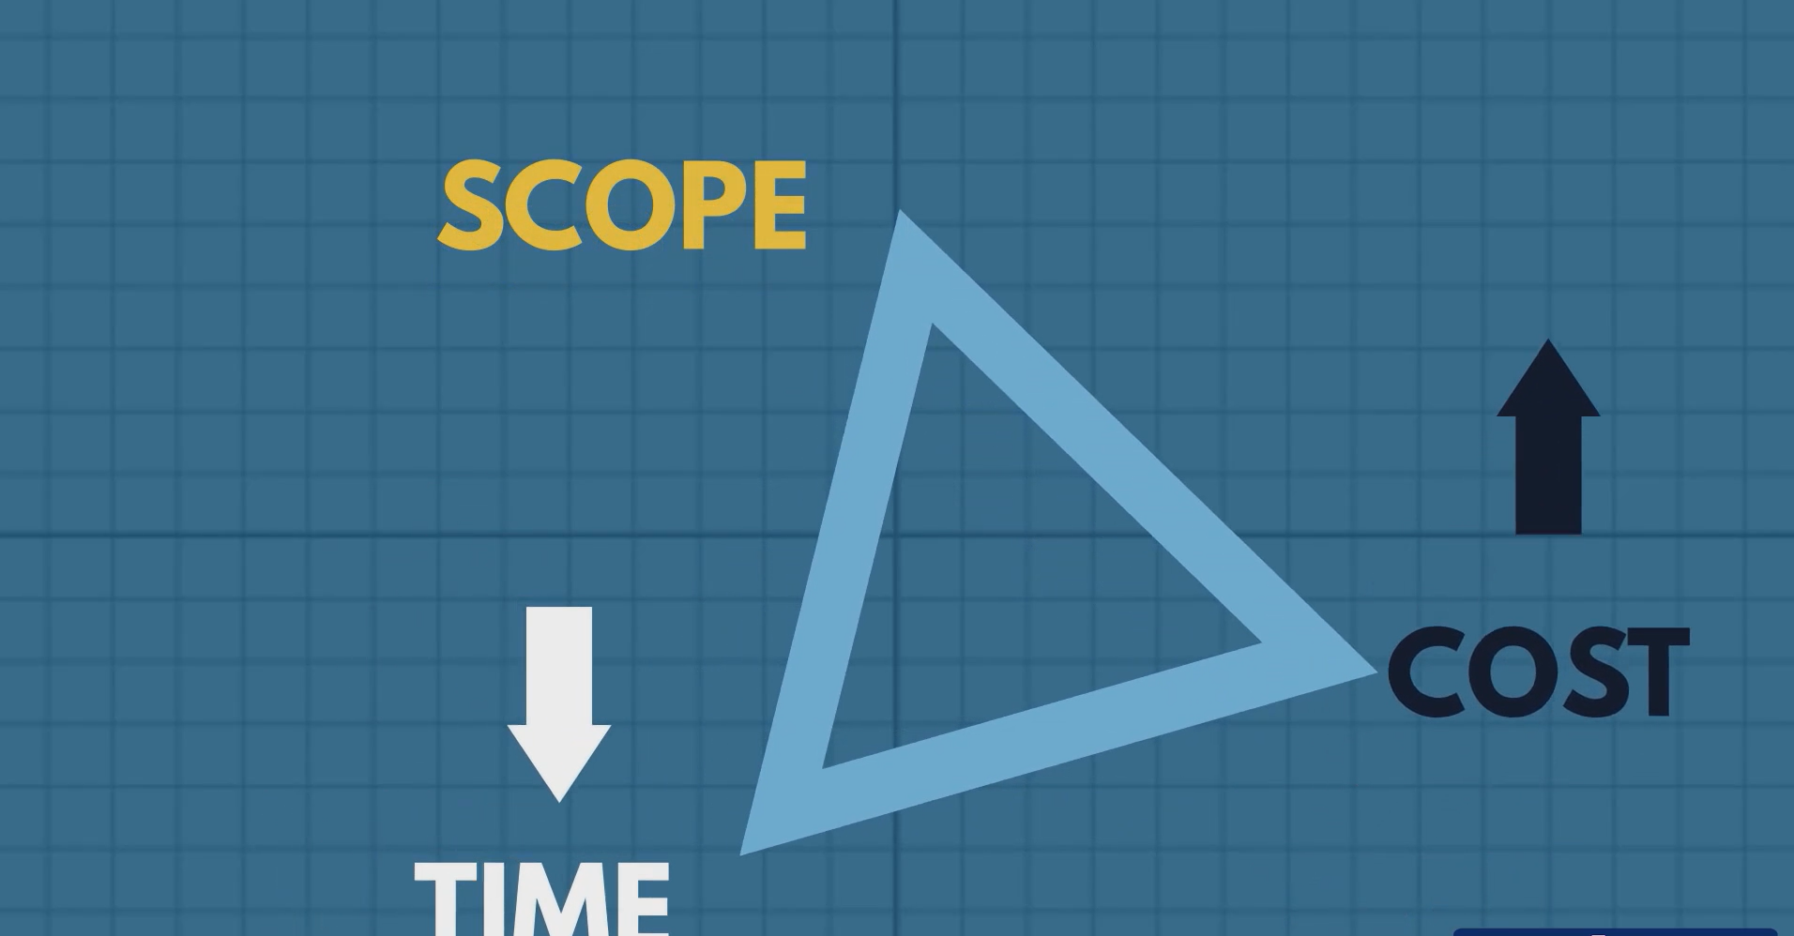

Slide 41
Project Triple Constraints
The Triple Constraint in project management refers to the three key factors that determine the success and balance of a project:
Triple Constraint = Scope + Time + Cost
These three elements are interdependent — changing one will likely affect the others.
Scope
What the project is supposed to deliver — the features, functions, and tasks.
If the scope increases (more features), it may require more time and cost.
Time
How long the project will take — the schedule and deadlines.
If the deadline is shortened, you may need more resources (cost) or reduce the scope.
Cost
How much money and resources are available — the budget.
If the budget is cut, you may need to reduce the scope or extend the timeline.

Slide 42
Project Triple Constraints
Developing a Mobile App
Scope: Build a food delivery app with real-time tracking, payment gateway, and user reviews.
Time: 3 months
Cost: $30,000
What happens if:
The client wants to add a new feature (e.g., live chat)? → Scope increases
You’ll need more time or more budget.
The deadline is moved up by 1 month? → Time decreases
You may need to hire more developers (higher cost) or reduce features (smaller scope).
The budget is cut to $20,000? → Cost decreases
You may need to remove some features or extend the timeline.

Slide 43
MCQ
1. What are the three components of the Triple Constraint in project management?
A. Budget, quality, and communication B. Scope, time, and cost C. Planning, execution, and closure D. Resources, risk, and quality
2. What happens if the scope of a project increases?
A. Time and cost may decrease B. Time and cost may increase C. The project becomes easier D. The project ends early
3. If a project’s deadline is shortened, what might be required?
A. Reduce the budget B. Increase the scope C. Add more resources or reduce scope D. Delay the project

Slide 44
MCQ
4. What is the effect of reducing the project budget?
A. Scope and time may need to be increased B. Scope or timeline may need to be reduced C. Quality will automatically improve D. The project will be completed faster
5. Why are the elements of the Triple Constraint considered interdependent?
A. They are managed by different teams B. Changing one affects the others C. They are unrelated to project success D. They are fixed throughout the project

Slide 45
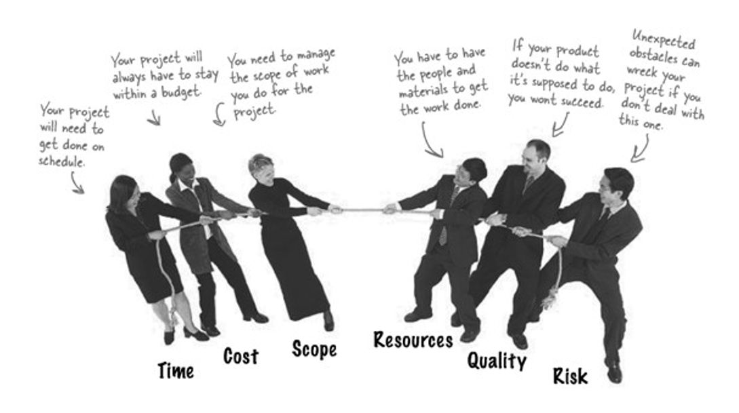

Slide 46
Project Constraints
In project management, project constraints are the limitations or boundaries within which a project must be executed. These constraints affect how the project is planned, executed, and delivered.
Understanding and managing them is crucial for a project manager to ensure project success.
Key Project Constraints
1. Scope
What the project is supposed to deliver.
Includes features, functions, and tasks.
Example: In an IT project, scope might include building a mobile app with login, payment, and tracking features.
2. Time
The schedule or deadline for the project.
Example: Delivering the app within 3 months.
3. Cost
The budget allocated for the project.
Example: The app development budget is $20,000.

Slide 47
Project Constraints
4. Quality
The standard or grade of the final deliverable.
Example: The app must be bug-free and user-friendly.
5. Resources
People, equipment, and materials needed.
Example: Developers, designers, and testing tools.
6. Risk
Potential problems that could affect the project.
Example: A key developer leaving mid-project or a change in client requirements.
7. Customer Satisfaction
Meeting or exceeding stakeholder expectations.
Example: The client is happy with the app’s performance and design.

Slide 48
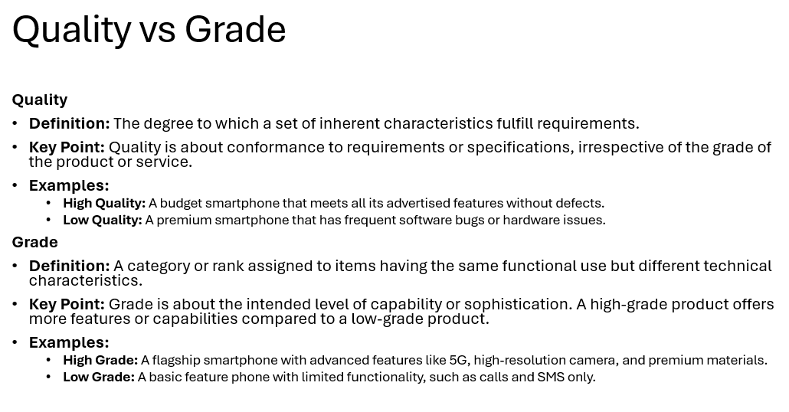

Slide 49
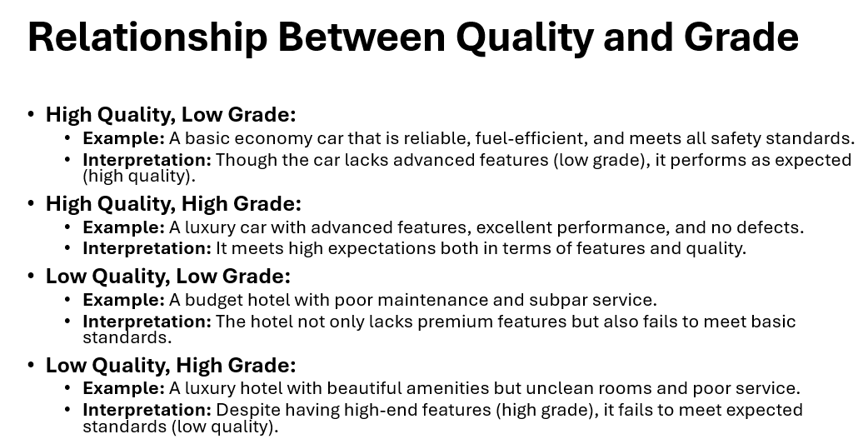

Slide 50
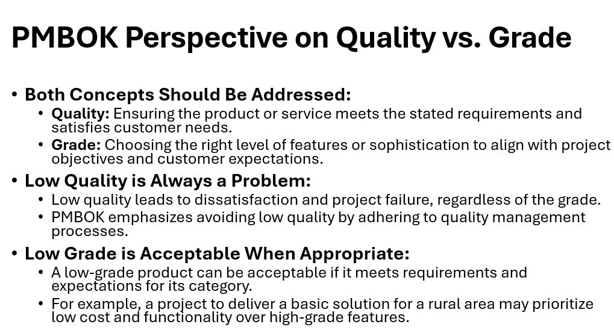

Slide 51
MCQ
1. What does the "Quality" constraint in project management refer to?
A. The number of team members B. The budget allocated for the project C. The standard or grade of the final deliverable D. The time taken to complete the project
2. Which of the following is considered a project resource?
A. Project deadline B. Client feedback C. Developers and testing tools D. Final product features
3. What is an example of a project risk?
A. Completing the project ahead of schedule B. A key developer leaving mid-project C. Receiving positive client feedback D. Having extra budget

Slide 52
MCQ
1. What does the "Quality" constraint in project management refer to?
A. The number of team members B. The budget allocated for the project C. The standard or grade of the final deliverable D. The time taken to complete the project
2. Which of the following is considered a project resource?
A. Project deadline B. Client feedback C. Developers and testing tools D. Final product features
3. What is an example of a project risk?
A. Completing the project ahead of schedule B. A key developer leaving mid-project C. Receiving positive client feedback D. Having extra budget

Slide 53
Why Are Constraints Important for a Project Manager?
Helps in Planning
Knowing constraints allows better scheduling and budgeting.
Supports Decision-Making
Helps prioritize tasks and allocate resources wisely.
Improves Risk Management
Identifying constraints early helps avoid surprises.
Ensures Project Success
Balancing constraints leads to timely, cost-effective, and high-quality delivery.
Facilitates Communication
Clear understanding of constraints helps manage stakeholder expectations.

Slide 54
Example
Example in IT Industry:
Project: Develop an e-learning platform
Scope: Video lessons, quizzes, and progress tracking
Time: 4 months
Cost: $50,000
Constraints: Limited budget, tight deadline, and high-quality expectations
The project manager must balance these constraints — maybe by using open-source tools or hiring freelancers to stay within budget and time.

Slide 55
As a Project Manager, What will you do
Prioritize and Refine the Scope
Break down features into must-have vs. nice-to-have.
Focus on core functionalities first:
MVP (Minimum Viable Product): Basic video lessons, simple quizzes, and progress tracking.
Defer advanced features (e.g., gamification, analytics) to future phases.
Agile Project Management
Use Agile methodology (e.g., Scrum) to deliver in iterations.
Break the 4-month timeline into bi-weekly sprints.
Regular reviews help ensure quality and allow for adjustments.

Slide 56
As a Project Manager, What will you do
Smart Resource Allocation
Hire a small, skilled team:
1–2 developers, 1 UI/UX designer, 1 QA tester.
Use open-source tools and cloud services to reduce costs.
Consider freelancers or outsourcing for specialized tasks.
Quality Assurance from Day One
Integrate automated testing and code reviews into each sprint.
Conduct user testing early to gather feedback and improve usability.
Maintain a clear definition of “done” for each feature.

Slide 57
As a Project Manager, What will you do
Risk Management
Identify risks early (e.g., delays, scope creep, tech issues).
Create contingency plans:
Buffer time in schedule.
Backup resources or tools.
Keep stakeholders informed with regular updates.
Stakeholder Engagement
Involve clients in sprint reviews and planning.
Use prototypes and demos to validate expectations.
Ensure customer satisfaction by aligning deliverables with their vision.

Slide 58
IT Projects
IT (Information Technology) projects involve the development, implementation, or maintenance of technology systems, software, or digital services.
An IT project (Information Technology project) is a temporary effort undertaken to create, improve, or implement a technology-based solution.
These projects typically involve software development, hardware installation, network setup, data management, or digital transformation.
Examples:
Developing a mobile app for online banking
Setting up a company’s cloud infrastructure
Creating a website for an e-commerce business
Implementing cybersecurity measures

Slide 59
IT Projects
Key Characteristics of IT Projects
Technology-Focused
Involves computers, software, networks, or digital systems.
Goal-Oriented
Aims to solve a problem or improve efficiency using technology.
Temporary
Has a defined start and end date.
Unique Deliverables
Produces a new app, system, website, or IT infrastructure.

Slide 60
IT Projects
Project Type | Example
Software Development | Creating a mobile app for online shopping
Website Design | Building a school website with student portals
System Implementation | Installing an ERP system in a manufacturing company
Network Setup | Setting up Wi-Fi and servers in a new office
Cybersecurity Enhancement | Implementing firewalls and encryption protocols
Data Migration | Moving data from old systems to cloud storage
IT Support Automation | Developing a chatbot for customer service
🔧 Examples of IT Projects

Slide 61
Traditional Projects
Traditional projects are non-IT projects, often involving physical construction, manufacturing, or other tangible outcomes.
Examples:
Building a bridge or a hospital
Organizing a cultural event
Manufacturing a new product line
Installing a water supply system in a village

Slide 62
IT Projects vs Traditional Projects
Aspect | IT Projects | Traditional Projects
Nature of Work | Digital, software-based | Physical, construction or manufacturing
Deliverables | Apps, websites, systems | Buildings, products, infrastructure
Tools Used | Programming languages, databases, cloud platforms | Construction tools, machinery, engineering equipment
Flexibility | High – Agile methods allow changes during execution | Low – Changes are costly and harder to implement
Team Composition | Developers, designers, testers | Engineers, architects, laborers
Testing | Virtual testing (QA, debugging) | Physical inspection and safety checks
Risk Factors | Bugs, security issues, tech failures | Weather, material delays, safety hazards
Project Management | Often uses Agile, Scrum, or DevOps | Often uses Waterfall or traditional PM methods

Slide 63

Why IT Project Management Is Important?
Ensures Clear Planning and Direction
Helps define project goals, scope, timeline, and budget.
Avoids confusion and sets expectations for everyone involved.
Example: Planning the development of a school management system with clear milestones and deadlines.
Improves Resource Management
Allocates developers, designers, testers, and tools effectively.
Prevents overuse or underuse of resources.
Example: Assigning specific tasks to team members based on their skills and availability.
Controls Time and Budget
Tracks progress to ensure the project stays on schedule and within budget.
Identifies delays or overspending early.
Example: Using tools like Jira or Trello to monitor task completion and budget usage.

Slide 64
Why IT Project Management Is Important?
Manages Risks and Issues
Identifies potential problems before they occur.
Develops backup plans to handle unexpected challenges.
Example: Preparing for server downtime during a website launch by having a cloud backup.
Enhances Communication
Keeps stakeholders, clients, and team members informed.
Promotes collaboration and transparency.
Example: Regular meetings and updates to ensure everyone is aligned on progress.
Delivers Quality Results
Ensures the final product meets user needs and quality standards.
Includes testing, feedback, and improvements.
Example: Testing a mobile app thoroughly before releasing it to users.
Supports Innovation and Growth
Encourages structured experimentation and development.
Helps organizations adapt to new technologies and market demands.
Example: Managing a project to integrate AI into customer support systems.

Slide 65
Role of IT Project Manager
Project Planning
Define project scope, objectives, and deliverables.
Create detailed schedules and allocate resources.
Example: Planning the development of a mobile app with milestones for design, coding, testing, and launch.
Team Coordination
Assemble and manage a team of developers, designers, testers, and analysts.
Assign tasks and ensure collaboration.
Example: Coordinating between frontend and backend developers to ensure smooth integration.
Budget and Time Management
Monitor project expenses and ensure the project stays within budget.
Track progress to meet deadlines.
Example: Using tools like Microsoft Project or Jira to manage timelines and costs.

Slide 66
Role of IT Project Manager
Risk Management
Identify potential risks and develop mitigation strategies.
Handle unexpected issues like system failures or resource shortages.
Example: Preparing a backup plan in case a key developer becomes unavailable.
Stakeholder Communication
Keep clients, sponsors, and team members informed.
Manage expectations and report progress.
Example: Presenting weekly updates to the client on the status of a software development project.
Quality Assurance
Ensure the final product meets technical and user requirements.
Oversee testing and validation processes.
Example: Supervising QA testing to ensure a bug-free release of a web application.
Project Closure
Finalize documentation, deliverables, and lessons learned.
Ensure smooth handover and client satisfaction.
Example: Delivering the final version of a CRM system and training the client’s staff to use it.

Slide 67
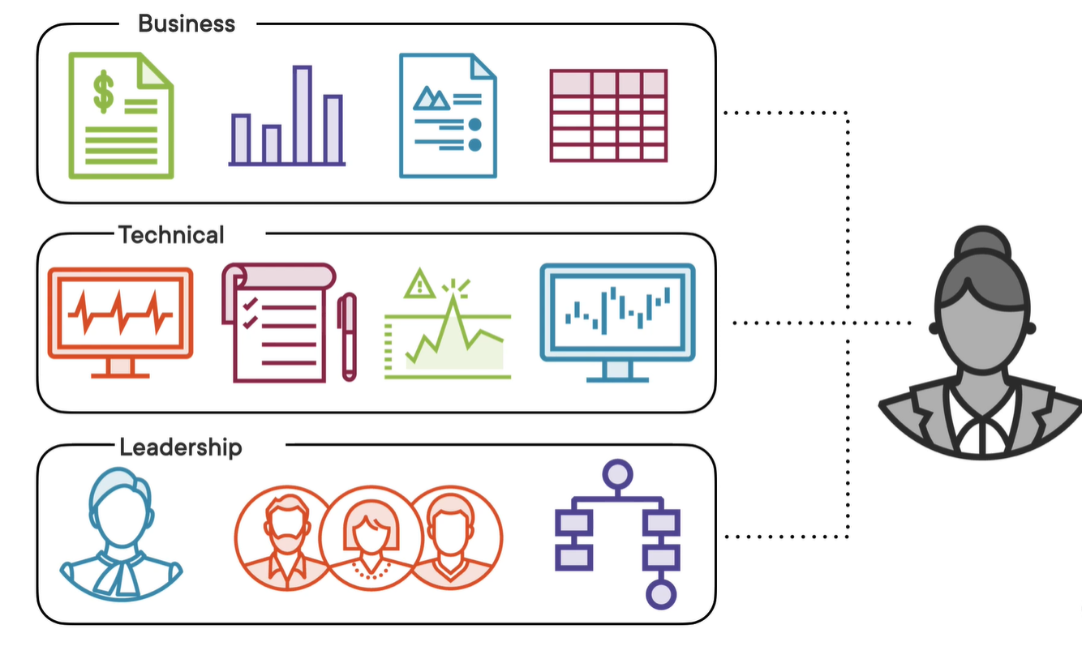
Skills of Project Manager

Slide 68
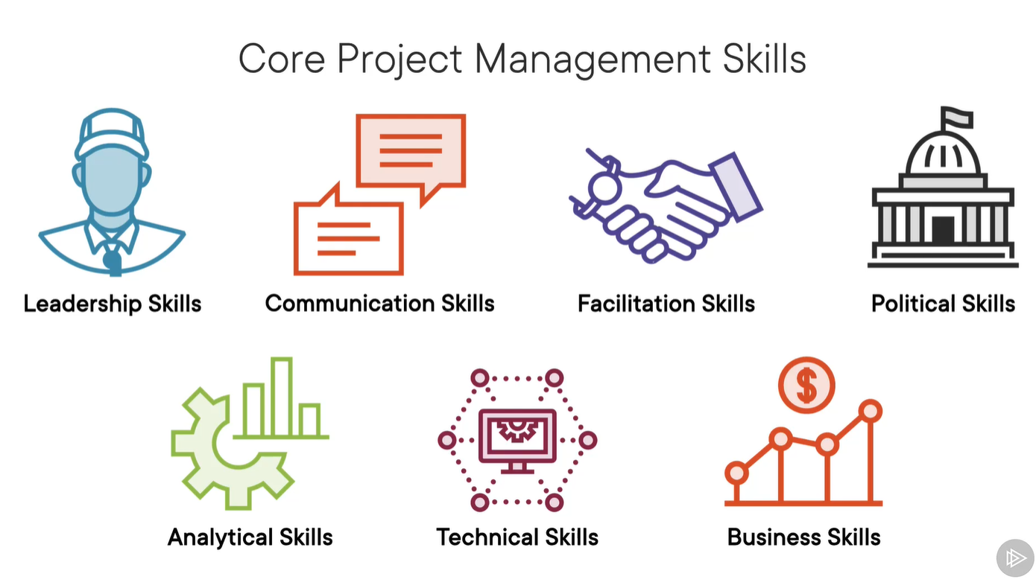

Slide 69
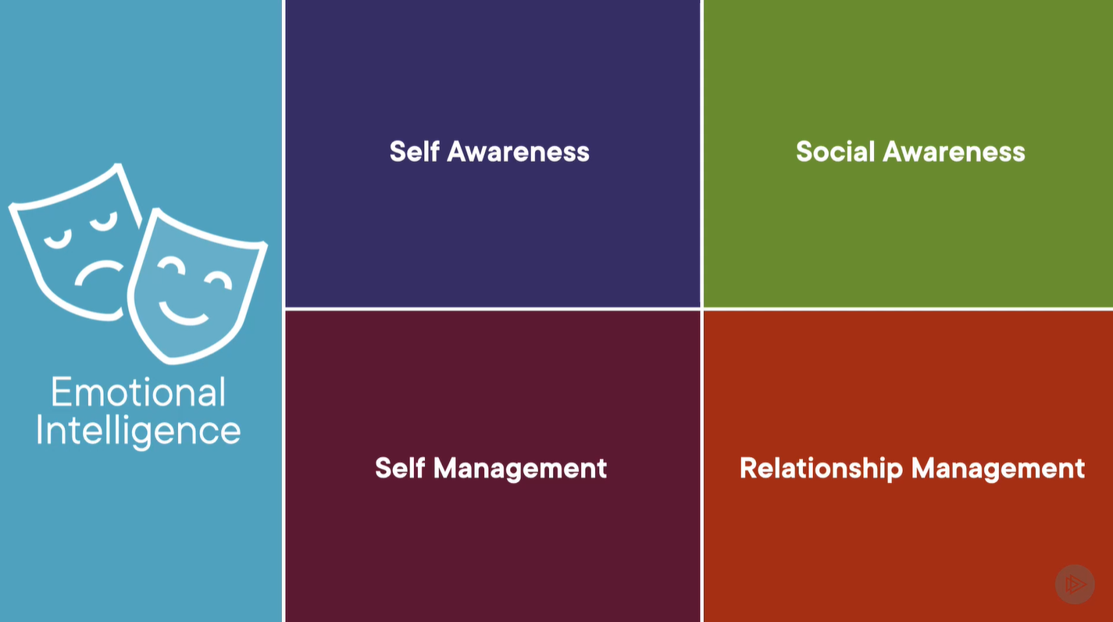

Slide 70
Essential Skills of a Project Manager
1. Leadership
Explanation: Inspiring and guiding the team toward achieving project goals.
Example: Motivating a team of developers during a tight deadline to stay focused and productive.
2. Communication
Explanation: Clearly conveying information to team members, stakeholders, and clients.
Example: Hosting weekly meetings to update stakeholders on project progress and challenges.
3. Time Management
Explanation: Prioritizing tasks and ensuring deadlines are met.
Example: Creating a Gantt chart to schedule tasks and monitor progress in a website development project.

Slide 71
Essential Skills of a Project Manager
4. Risk Management
Explanation: Identifying potential problems and planning how to avoid or handle them.
Example: Preparing a backup plan in case a software update causes system downtime.
5. Problem-Solving
Explanation: Finding solutions to unexpected issues during the project.
Example: Resolving a conflict between team members or fixing a bug that delays deployment.
6. Negotiation
Explanation: Reaching agreements with clients, vendors, or team members.
Example: Negotiating with a client to extend the deadline in exchange for additional features.

Slide 72
Essential Skills of a Project Manager
7. Budgeting
Explanation: Managing project finances and ensuring spending stays within limits.
Example: Allocating funds for software licenses, team salaries, and testing tools.
8. Technical Knowledge (especially in IT projects)
Explanation: Understanding the technology being used to make informed decisions.
Example: Knowing how APIs work to guide developers in integrating third-party services.
9. Adaptability
Explanation: Adjusting plans and strategies when project conditions change.
Example: Switching from Waterfall to Agile methodology when client requirements evolve.
10. Organizational Skills
Explanation: Keeping project documents, schedules, and resources well-managed.
Example: Using project management tools like Trello or Asana to track tasks and deadlines.

Slide 73

Skills of IT Project Manager
Technical Skills
Project Management Methodologies
Agile, Scrum, Kanban, Waterfall, Hybrid
PMP, PRINCE2, or Scrum Master certification
Software Development Life Cycle (SDLC) Understanding
Knowledge of phases: requirements, design, development, testing, deployment, and maintenance
IT Infrastructure Knowledge
Networking, cloud computing (AWS, Azure, GCP), databases, cybersecurity basics
Project Management Tools
Tools like Jira, Trello, Microsoft Project, Asana, Monday.com, or ClickUp
Risk Management
Identifying, analyzing, mitigating risks and managing issues throughout the project
Budgeting and Resource Management
Cost estimation, budget tracking, resource allocation, and utilization
Data and Metrics Interpretation
KPIs, burndown charts, velocity, earned value management (EVM)
Contract & Vendor Management
Working with third-party vendors, drafting contracts, managing SLAs

Slide 74
Skills of IT Project Manager
Analytical & Problem-Solving Skills
Critical Thinking
Ability to analyze project issues and derive logical solutions quickly
Decision-Making
Making timely decisions considering business and technical impact
Leadership & Interpersonal Skills
Team Leadership
Motivating cross-functional teams, resolving conflicts, and ensuring productivity
Communication
Clear communication with stakeholders, team members, and clients (both technical and non-technical)
Stakeholder Management
Managing expectations, engagement, and communication with key stakeholders
Negotiation
Managing scope creep, deadlines, budgets, and vendor agreements effectively

Slide 75
Skills of IT Project Manager
Organizational Skills
Time Management
Managing timelines, setting priorities, and ensuring on-time delivery
Multitasking
Juggling multiple projects or tasks simultaneously without losing track
Documentation
Preparing project charters, status reports, meeting minutes, risk logs, and closure reports
Adaptability & Learning
Tech Savvy
Staying updated with emerging technologies and software trends
Change Management
Handling organizational change and facilitating team adaptation

Slide 76
Case Study: Successful IT Project – Google Chrome
Project Name: Google Chrome Browser
Company: Google
Goal: Create a fast, secure, and user-friendly web browser
Launch Year: 2008
Why It Succeeded:
Factor | Description
Clear Vision | Google aimed to improve web browsing speed and security.
Strong Leadership | Led by experienced engineers and product managers.
User-Centered Design | Focused on simplicity and performance.
Agile Development | Frequent updates and user feedback integration.
Resource Availability | Google had the budget, talent, and infrastructure.
Outcome:
Became the world’s most popular browser.
Set new standards for speed and security in web browsing.

Slide 77
Case Study: Successful IT Project – Google Chrome
Overview
Google Chrome is a web browser developed by Google, first released in 2008. It quickly became one of the most widely used browsers globally due to its speed, simplicity, and security. This case study explores how Chrome became a successful IT project through effective project management.
Project Goal
To develop a fast, secure, and user-friendly web browser that supports modern web standards and provides a better user experience than existing browsers.
Project Scope
Core Features:
Fast browsing performance
Minimalist user interface
Tabbed browsing
Built-in security features
Support for web standards (HTML5, CSS3, JavaScript)
Additional Features:
Extensions and plugins
Developer tools
Sync across devices

Slide 78
Case Study: Successful IT Project – Google Chrome
Timeline
Start: Early 2006 (internal development)
Public Release: September 2008
Ongoing Updates: Every 6 weeks (Agile release cycle)
Cost & Resources
Budget: Funded internally by Google
Team: Software engineers, UI/UX designers, QA testers, security experts
Tools: Open-source Chromium engine, Agile development tools
Quality Management
Focused on:
Speed and performance benchmarks
Security testing and sandboxing
User feedback and usability testing
Continuous integration and automated testing ensured high standards.

Slide 79
Case Study: Successful IT Project – Google Chrome
Risk Management
Risks Identified:
Competing with established browsers (IE, Firefox)
Performance issues on older devices
Security vulnerabilities
Mitigation Strategies:
Open-source development for transparency
Frequent updates and patches
Beta testing with real users
Customer Satisfaction
Chrome’s clean interface and fast performance led to high user adoption.
Regular updates and community involvement kept users engaged.
Chrome became the most popular browser globally by 2012.

Slide 80
Case Study: Successful IT Project – Google Chrome
Constraint | Management Strategy
Scope | Focused on essential features first, added more over time
Time | Agile development with frequent releases
Cost | Efficient use of internal resources and open-source tools

Slide 81
Case Study: Successful IT Project – Google Chrome
Lessons Learned
Start with a clear MVP (Minimum Viable Product)
Use Agile for flexibility and speed
Prioritize user experience and security
Engage the community for feedback and innovation

Slide 82
Case Study: Successful IT Project – Apple iPhone
Overview:
Project: Development of the first iPhone
Company: Apple Inc.
Launch Year: 2007
Goal: Create a revolutionary smartphone combining phone, music, and internet
Why It Succeeded:
Clear Vision: Steve Jobs had a bold vision to redefine mobile phones.
Strong Leadership: The project was led by experienced teams with clear direction.
Innovation: Combined multiple technologies into one sleek device.
User-Centered Design: Focused on simplicity and user experience.
Controlled Secrecy: Maintained tight control over leaks and development.
Outcome:
The iPhone became a global success, transforming the smartphone industry and making Apple one of the most valuable companies in the world.

Slide 83
Case Study: Successful IT Project – Apple iPhone
Overview
The Apple iPhone, launched in 2007, revolutionized the smartphone industry. It combined a phone, iPod, and internet communicator into one device. This case study explores how Apple managed the iPhone project successfully through innovation, strategic planning, and strong project management.
Project Goal
To create a touchscreen-based smartphone that integrates communication, entertainment, and internet access in a single, user-friendly device.

Slide 84
Case Study: Successful IT Project – Apple iPhone
Project Scope
Core Features:
Multi-touch interface
Visual voicemail
Mobile Safari browser
Music and video playback
Extended Features (added in later versions):
App Store
GPS and maps
Siri (voice assistant)
FaceTime and advanced cameras
Apple focused on user experience, design, and functionality as key scope elements.

Slide 85
Case Study: Successful IT Project – Apple iPhone
Timeline
Start: 2004 (Project Purple)
Announcement: January 2007
Release: June 2007
Ongoing Development: Annual updates with new models and features
Cost & Resources
Budget: High investment from Apple’s R&D
Resources:
Engineers, designers, marketers
Collaboration with suppliers (e.g., Samsung for chips)
Proprietary software and hardware development

Slide 86
Case Study: Successful IT Project – Apple iPhone
Quality Management
Rigorous hardware and software testing
Focus on design precision and user interface
Controlled ecosystem (iOS) ensured consistent quality
Frequent updates and bug fixes post-launch
Risk Management
Risks:
Market skepticism about touchscreen phones
High development costs
Supply chain complexity
Mitigation:
Strong marketing and brand positioning
Strategic partnerships with carriers (e.g., AT&T)
Controlled product launch and limited initial availability

Slide 87
Case Study: Successful IT Project – Apple iPhone
Customer Satisfaction
High satisfaction due to:
Intuitive design
Seamless integration of features
Regular updates and support
Created a loyal customer base and strong brand identity
Constraint | Management Strategy
Scope | Focused on innovation and user experience
Time | Secretive development with a clear launch deadline
Cost | High investment balanced by premium pricing and market success
📊 Triple Constraint Analysis

Slide 88
Case Study: Successful IT Project – Apple iPhone
Lessons Learned
Innovation requires bold decisions and investment
User experience is key to product success
Secrecy and control can help manage risks
Strategic partnerships enhance market entry

Slide 89
Case Study: Nokia’s Failed Mobile Phone Business
Background:
Company: Nokia (Finland)
Industry: Mobile Phones / Telecommunications
Peak: Early 2000s – Nokia was the global leader in mobile phone sales
Decline Period: 2007–2015
Reasons for Failure:
Resistance to Smartphone Evolution
Nokia underestimated the shift toward smartphones and touchscreens.
Believed users would prefer physical keypads over touch interfaces.
Result: Lost ground to Apple’s iPhone and Android-based phones 1
Poor Strategic Decisions
Chose to stick with the outdated Symbian OS instead of adopting Android.
Later partnered with Microsoft to use Windows Phone OS, which failed to gain traction

Slide 90
Case Study: Nokia’s Failed Mobile Phone Business
Lack of Innovation
Failed to keep up with competitors in terms of app ecosystems, user experience, and design.
Released phones that were technologically behind market leaders.
Internal Management Issues
Slow decision-making and organizational restructuring weakened execution.
Leadership conflicts and unclear vision led to missed opportunities .
Marketing Missteps
Nokia’s branding and messaging didn’t resonate with the new generation of smartphone users.
Failed to build developer support for its platforms.

Slide 91
Case Study: Nokia’s Failed Mobile Phone Business
Lessons Learned:
Mistake | Lesson
Ignoring market trends | Always adapt to technological shifts
Poor platform choice | Choose scalable and developer-friendly ecosystems
Slow innovation | Stay ahead with user-focused design and features
Weak leadership | Strong, visionary leadership is critical
Outcome:
Nokia’s mobile division was sold to Microsoft in 2014.
Microsoft eventually shut down the Nokia phone business due to continued losses.
Nokia shifted focus to telecommunications infrastructure (e.g., 5G networks).

Slide 92
Case Study: Nokia’s Failed Mobile Phone Business
Overview
Nokia was once the global leader in mobile phones, dominating the market in the early 2000s. However, by the mid-2010s, it had lost its position to competitors like Apple and Samsung. This case study explores the reasons behind Nokia’s decline and the lessons that can be learned from its failed IT strategy.
Project Goal
To maintain global leadership in mobile phone technology by continuing to innovate and deliver high-quality, user-friendly devices.
Scope and Strategy
Early Success:
Strong brand recognition
Durable hardware and long battery life
Global distribution and market penetration
Strategic Focus:
Symbian OS as the core platform
Feature phones with limited internet capabilities
Focus on hardware over software innovation

Slide 93
Case Study: Nokia’s Failed Mobile Phone Business
Timeline
Peak: Early 2000s (market share over 40%)
Decline Begins: 2007 (iPhone launch)
Critical Years: 2008–2013 (failure to adapt)
Exit: 2014 (sold mobile division to Microsoft)
Cost & Resource Management
Nokia had significant R&D investment but failed to pivot effectively.
Resources were heavily tied to Symbian OS, which became outdated.
Internal conflicts and slow decision-making hindered innovation.
Quality Management
Nokia phones were known for hardware quality.
However, software experience lagged behind competitors.
Lack of app ecosystem and poor user interface contributed to customer dissatisfaction.

Slide 94
Case Study: Nokia’s Failed Mobile Phone Business
Risk Management
Risks Ignored:
Rise of smartphones and touchscreens
Shift toward app-based ecosystems
Failed Mitigation:
Late adoption of Windows Phone OS
Poor partnership execution with Microsoft
Resistance to Android adoption
Customer Satisfaction
Initially high due to reliability and brand trust.
Declined rapidly as users shifted to smartphones with better UX and app support.
Nokia failed to meet evolving customer expectations.
Triple Constraint Analysis
Constraint | Management Outcome
Scope | Focused too long on feature phones and Symbian OS
Time | Delayed response to market changes
Cost | High R&D spending with low strategic return

Slide 95
Case Study: Nokia’s Failed Mobile Phone Business
Lessons Learned
Adaptability is key in tech industries.
Software and ecosystem matter as much as hardware.
Ignoring market trends can be fatal.
Strategic partnerships must be well-executed and timely.

Slide 96
Successful IT Project: Amazon Web Services (AWS)
Overview:
Company: Amazon
Project: Launch of Amazon Web Services (AWS)
Year: 2006
Goal: Provide scalable cloud computing services to businesses and developers
Why It Succeeded:
Clear Market Need: Businesses needed scalable, affordable cloud infrastructure.
Strong Execution: Amazon leveraged its existing infrastructure and expertise.
Innovation: Introduced pay-as-you-go cloud services, transforming IT operations.
Scalability: AWS grew rapidly, adding services like storage, databases, and AI tools.
Outcome:
AWS became the world’s leading cloud platform, generating billions in revenue and powering companies like Netflix, Airbnb, and NASA.

Slide 97
Failed IT Project: Windows Vista
Overview:
Company: Microsoft
Project: Windows Vista Operating System
Year: Released in 2007
Goal: Replace Windows XP with a more secure and modern OS
Why It Failed:
Performance Issues: Vista was slow and resource-heavy.
Compatibility Problems: Many existing applications and drivers didn’t work.
Poor User Experience: Frequent security prompts frustrated users.
Delayed Launch: The project faced multiple delays and missed expectations.
Outcome:
Vista was widely criticized and quickly replaced by Windows 7 in 2009.
It damaged Microsoft’s reputation temporarily and led to a major internal overhaul.

Slide 98
Roles of IT Project Manager
Project Planning
Define scope, objectives, timeline, and deliverables
Develop project schedule and budget
Team Management
Assign roles, responsibilities, and tasks
Motivate and manage the project team
Execution and Monitoring
Track progress, KPIs, and milestones
Manage risks, issues, and changes
Stakeholder Communication
Report project status to stakeholders
Facilitate meetings and maintain alignment
Budget and Resource Management
Control costs and ensure optimal use of resources

Slide 99
Roles of IT Project Manager
Quality Assurance
Ensure deliverables meet quality and compliance standards
Vendor and Third-Party Management
Coordinate with external vendors and monitor service delivery
Risk and Issue Management
Identify potential risks and implement mitigation strategies
Project Closure
Ensure final delivery, documentation, and lessons learned
Change Management
Handle scope changes and guide teams through transitions

Slide 100
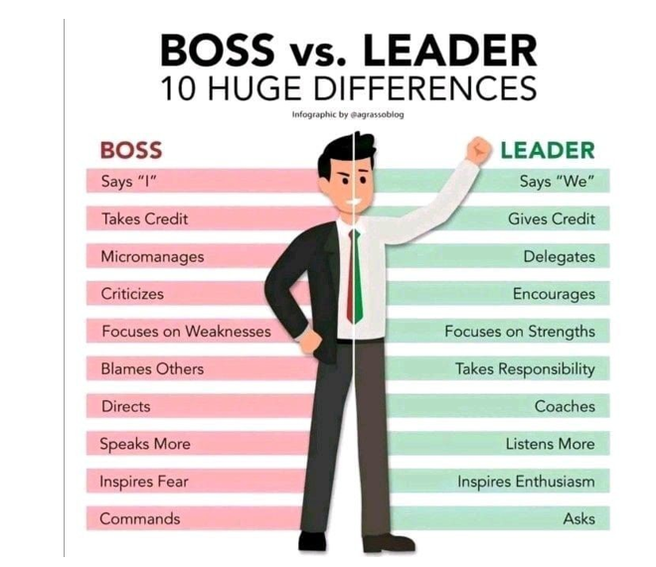

Slide 101
